Slide 1

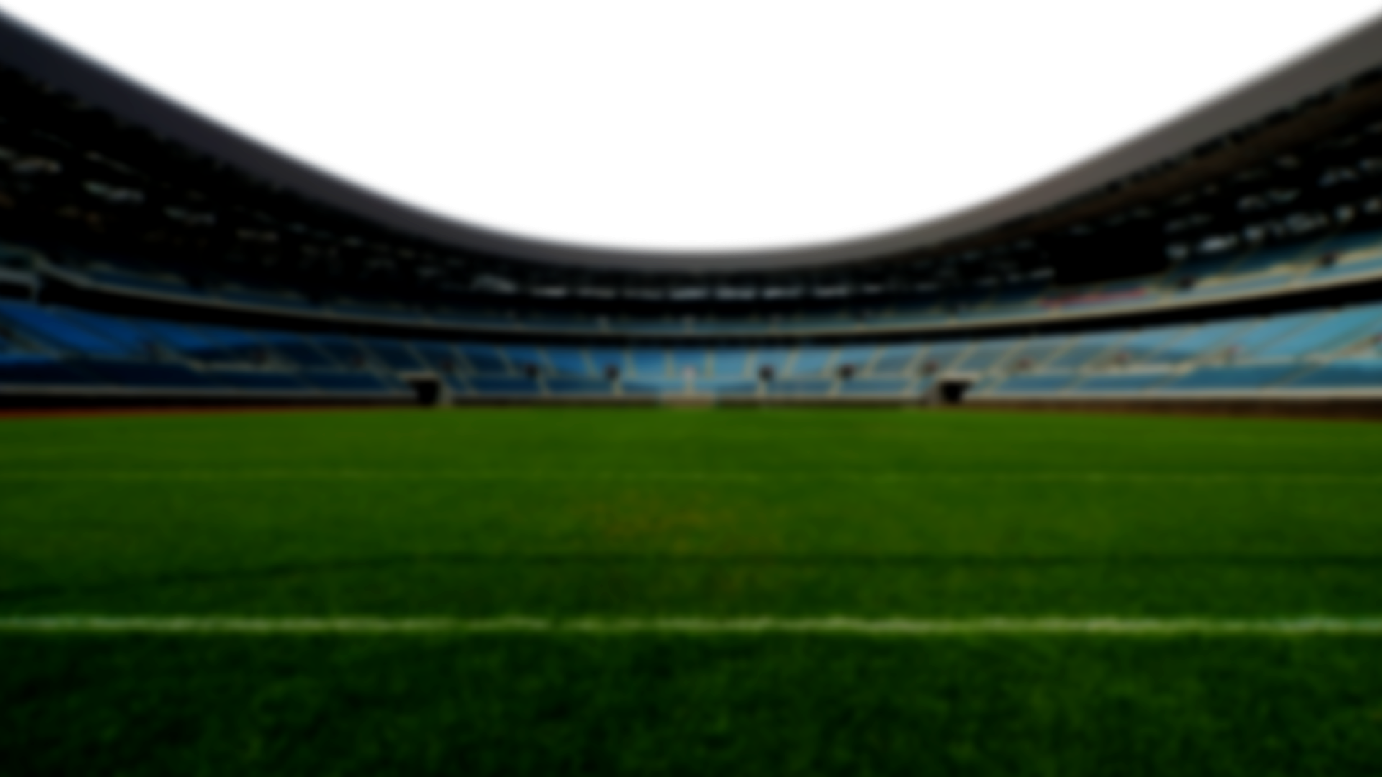





FIFA WORLD CUP

Slide 2
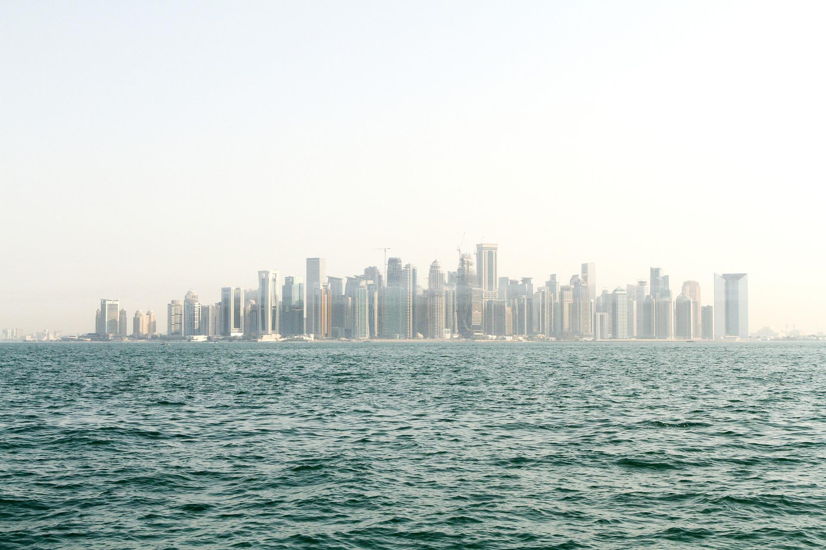
About Qatar
FIFA WORLD CUP
The State of Qatar is a sovereign and independent state in the Middle East, occupying a peninsula that juts into the Arabian Gulf.
A month-long World cup will be played from November 21 to December 18, 2022, in eight beautifully crafted stadiums located in different cities across Qatar.
22
08
65
Edition
Stadiums
Matches

Slide 3
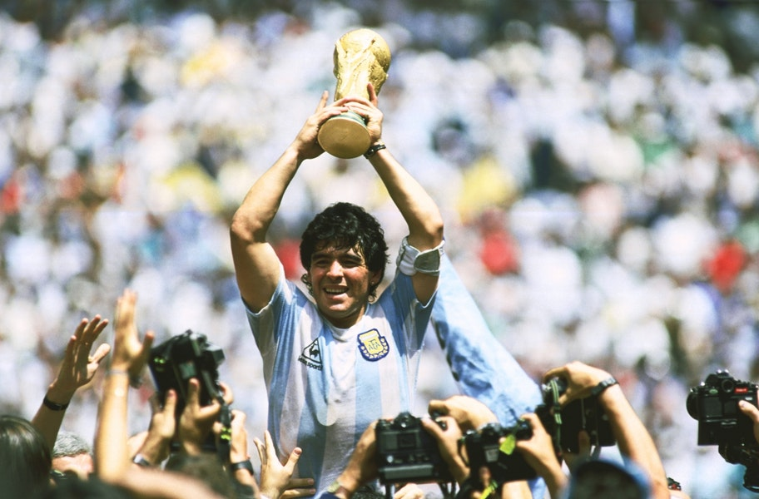
History of World Cup
FIFA WORLD CUP
The FIFA World Cup was first held in 1930, when FIFA, the world's football governing body, decided to stage an international men's football tournament under the era of FIFA president Jules Rimet who put this idea into place. The inaugural edition, held in 1930, was contested as a final tournament of only thirteen teams invited by the organization. Since then, the World Cup has experienced successive expansions and format remodeling, with its current 32-team final tournament preceded by a two-year qualifying process, involving over 200 teams from around the world.

Slide 4

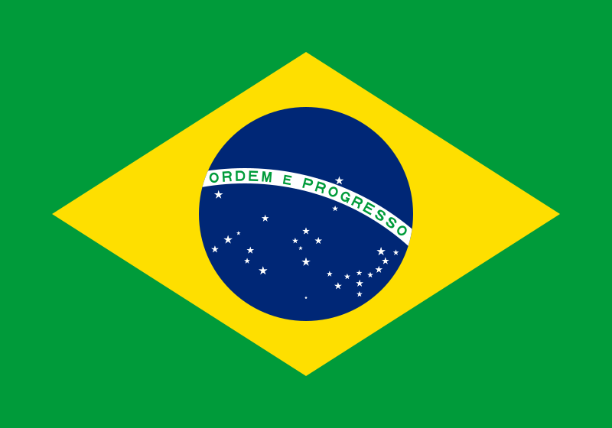






World Cup Winners
1930
Uruguay
1962
Brazil
1986
Argentina
2010
Spain
1934
Italy
1966
England
1990
Germany
2014
Germany
1938
Italy
1970
Brazil
1994
Brazil
2018
France
1950
Uruguay
1974
Germany
1998
France
1954
Germany
1978
Argentina
2002
Brazil
1958
Brazil
1982
Germany
2006
Italy

Slide 5
FIFA WORLD CUP
Stadiums in Qatar
01
-
Al Bayt Stadium
02
-
Lusail Stadium
03
-
Ahmad Bin Ali Stadium
01
04
-
Education City Stadium
03
04
06
02
05
-
Khalifa International Stadium
05
07
06
-
Stadium 974
08
07
-
Al Thumama Stadium
08
-
Al Janoub Stadium

Slide 6
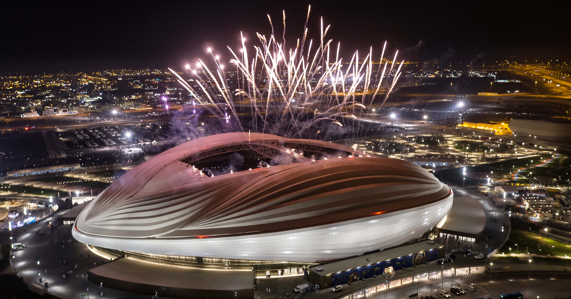
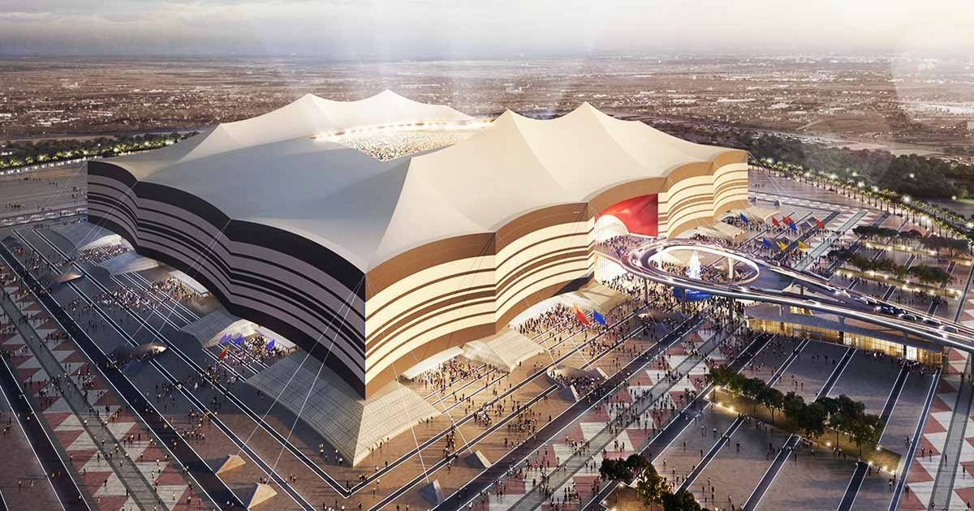
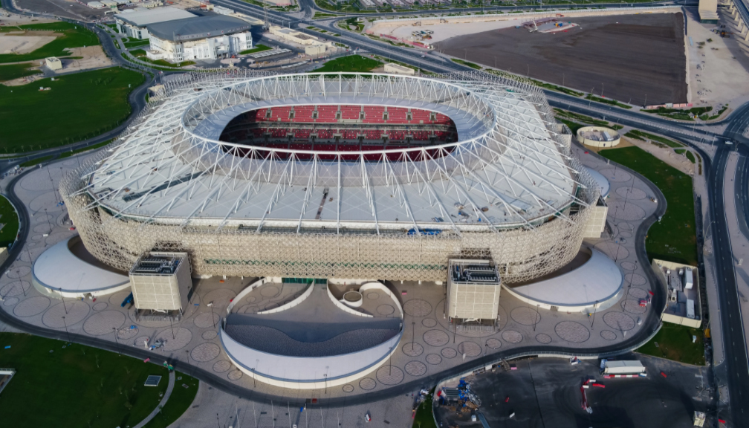
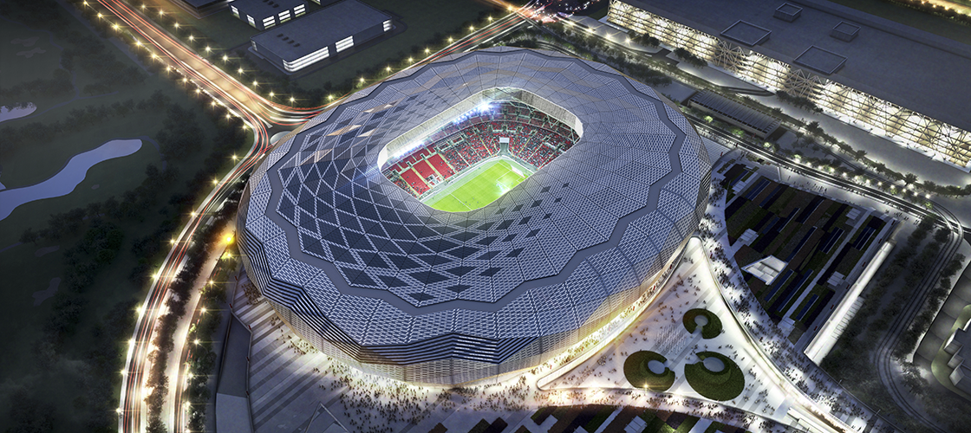
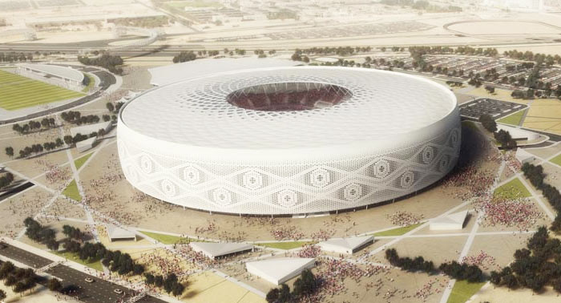
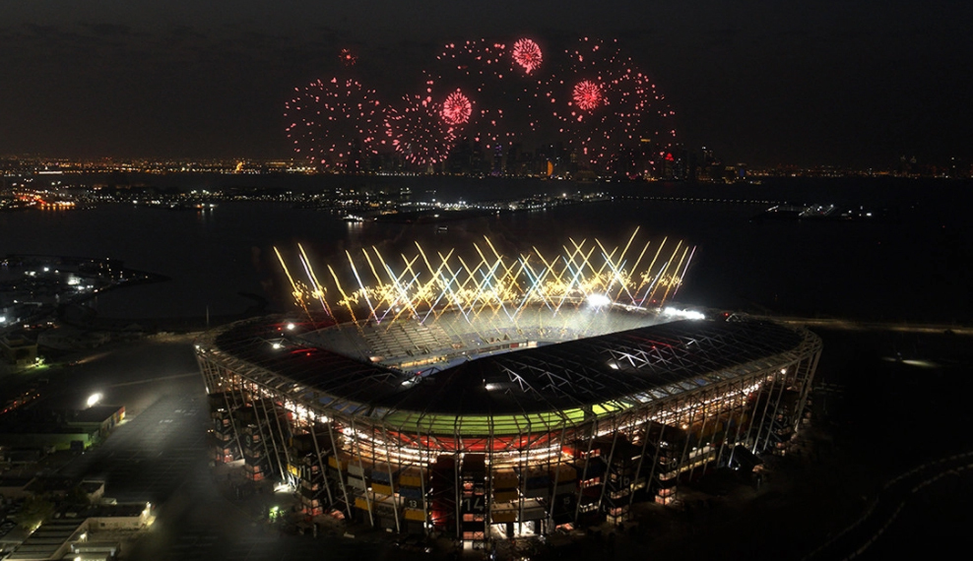
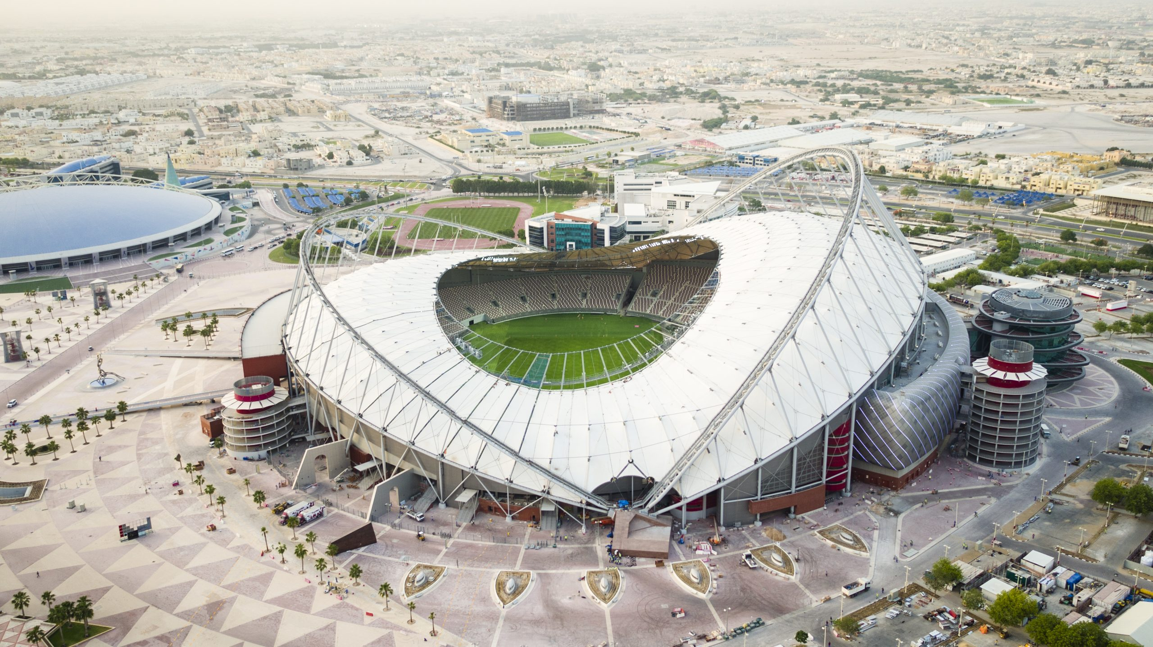
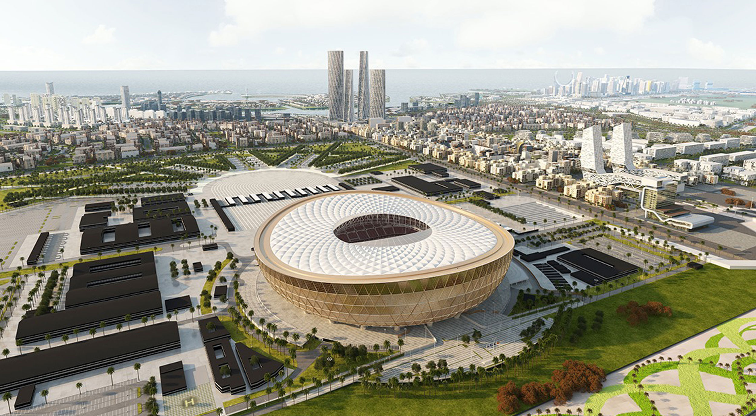
FIFA WORLD CUP
Stadiums in Qatar
Al Janoub
Al Bayt
Ahmad bin Ali
Education City
Al Thumama
Stadium 974
Khalifa International
Lusail

Slide 7
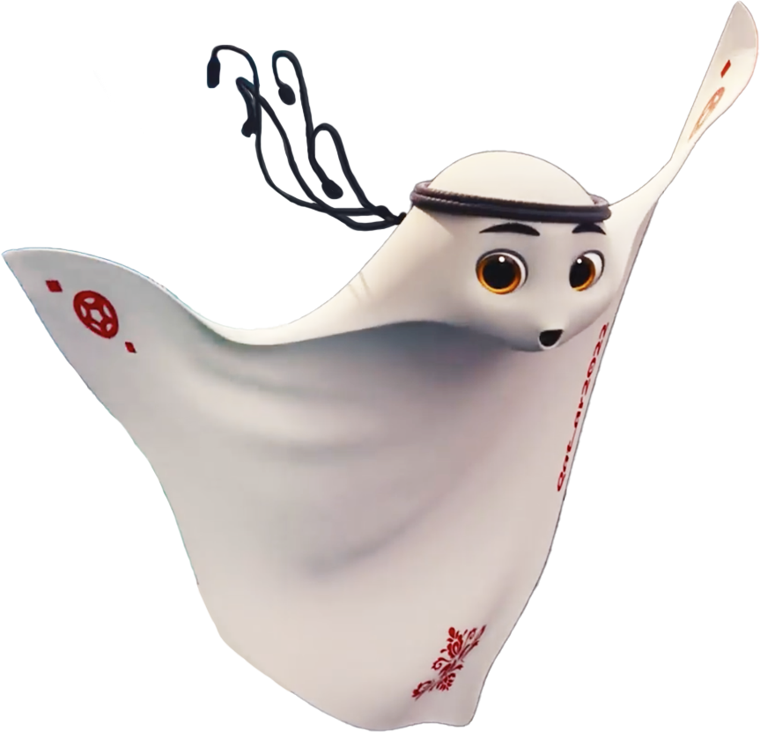
Meet La’eeb
La’eeb is an Arabic word meaning super-skilled player. He belongs to a parallel mascot verse that is indescribable — everyone is invited to interpret what it looks like. La’eeb, is playful, adventurous and curious and can be seen wearing the Qatari national dress.
FIFA WORLD CUP

Slide 8
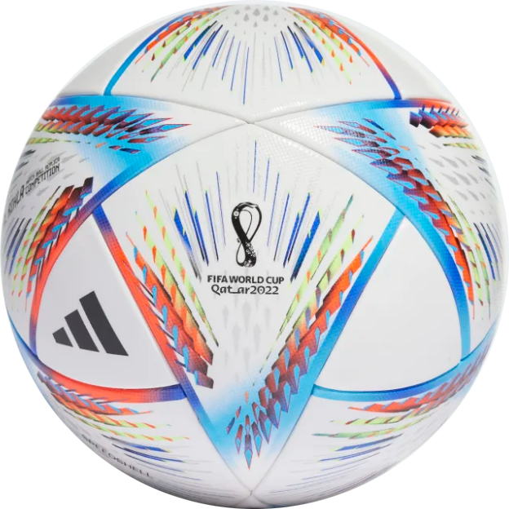
Official Ball
Al Rihla, the official Match Ball of 2022 FIFA World Cup in Qatar was unveiled by Adidas on 30th March 2022. Al Rihla translates as “the journey” in Arabic and has been inspired by the architecture, iconic boats, and the Flag of Qatar.
360° Full View
FIFA WORLD CUP

Slide 9


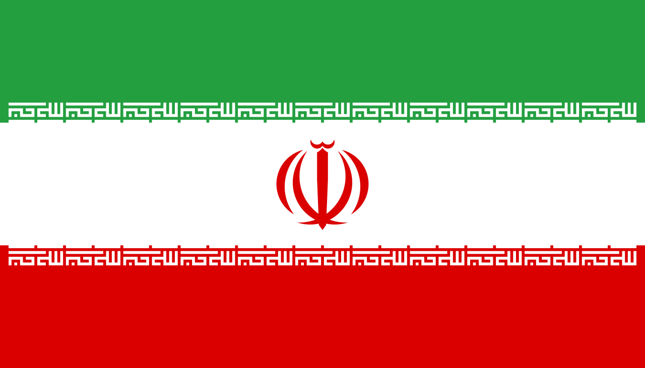
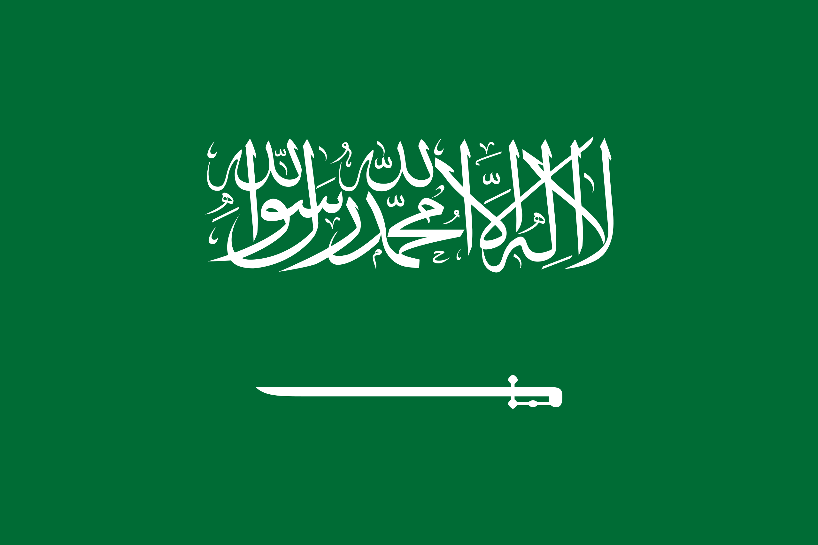









Participating Teams
The 2022 men's World Cup in Qatar will feature 32 teams divided into 8 different groups.
Group A
Group B
Group C
Group D
Qatar
England
Argentina
France
Ecuador
IR Iran
Saudi Arabia
Australia
Senegal
USA
Mexico
Denmark
Netherlands
Wales
Poland
Tunisia
FIFA WORLD CUP

Slide 10












Participating Teams
Group E
Group F
Group G
Group H
Spain
Belgium
Brazil
Portugal
Costa Rica
Canada
Serbia
Ghana
Germany
Morocco
Switzerland
Uruguay
Japan
Croatia
Cameroon
Korea Republic
FIFA WORLD CUP

Slide 11
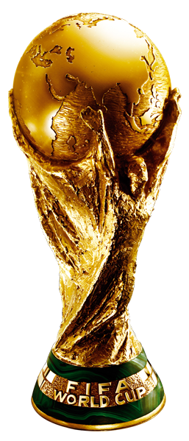
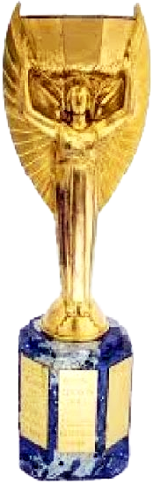

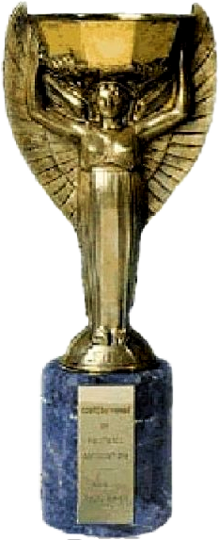
Trophy Evolution (1930 - 2022)
Modern-day Fifa world cup design features two athletes’ bodies holding hands and supporting the earth.
Jules Rimet Trophy originally named Victory, but later renamed in honor of FIFA president Jules Rimet.
FIFA WORLD CUP

Slide 12
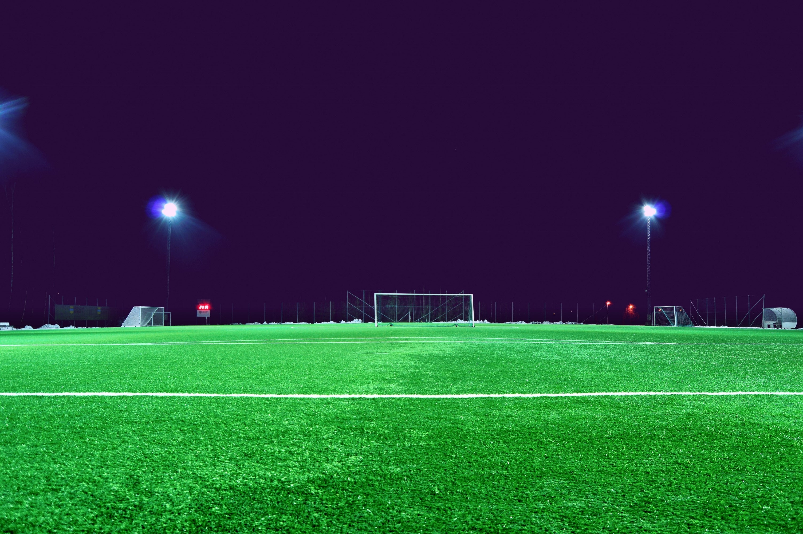

World Cup Fixtures
Arabia Standard Time (AST) UTC+03:00
01:00 pm
21 Nov 2022
04:00 pm
21 Nov 2022
Senegal
VS
Netherlands
England
VS
IR Iran
Monday
Al Thumama
Monday
Khalifa International
07:00 pm
21 Nov 2022
10:00 pm
21 Nov 2022
Qatar
VS
Ecuador
USA
VS
Wales
Monday
Al Bayt
Monday
Ahmad Bin Ali
FIFA WORLD CUP

Slide 13
Al Janoub Stadium
Arabia Standard Time (AST) UTC+03:00
10:00 pm
22 Nov 2022
01:00 pm
28 Nov 2022
France
VS
Australia
Cameroon
VS
Serbia
01:00 pm
24 Nov 2022
06:00 pm
30 Nov 2022
Switzerland
VS
Cameroon
Australia
VS
Denmark
01:00 pm
26 Nov 2022
06:00 pm
02 Dec 2022
Tunisia
VS
Australia
Ghana
VS
Uruguay
FIFA WORLD CUP

Slide 14
Al Bayt Stadium
Arabia Standard Time (AST) UTC+03:00
07:00 pm
21 Nov 2022
10:00 pm
27 Nov 2022
Qatar
VS
Ecuador
Spain
VS
Germany
01:00 pm
23 Nov 2022
06:00 pm
29 Nov 2022
Morocco
VS
Croatia
Netherlands
VS
Qatar
10:00 pm
25 Nov 2022
01:00 pm
01 Dec 2022
England
VS
USA
Costa Rica
VS
Germany
FIFA WORLD CUP

Slide 15
Ahmad bin Ali Stadium
Arabia Standard Time (AST) UTC+03:00
10:00 pm
21 Nov 2022
01:00 pm
27 Nov 2022
USA
VS
Wales
Japan
VS
Costa Rica
10:00 pm
23 Nov 2022
10:00 pm
29 Nov 2022
Belgium
VS
Canada
Wales
VS
England
01:00 pm
25 Nov 2022
06:00 pm
01 Dec 2022
Wales
VS
IR Iran
Croatia
VS
Belgium
FIFA WORLD CUP

Slide 16
Education City Stadium
Arabia Standard Time (AST) UTC+03:00
04:00 pm
22 Nov 2022
04:00 pm
28 Nov 2022
Denmark
VS
Tunisia
Korea Republic
VS
Ghana
04:00 pm
24 Nov 2022
06:00 pm
30 Nov 2022
Uruguay
VS
Korea Republic
Tunisia
VS
France
04:00 pm
26 Nov 2022
06:00 pm
02 Dec 2022
Poland
VS
Saudi Arabia
Korea Republic
VS
Portugal
FIFA WORLD CUP

Slide 17
Al Thumama Stadium
Arabia Standard Time (AST) UTC+03:00
01:00 pm
21 Nov 2022
04:00 pm
27 Nov 2022
Senegal
VS
Netherlands
Belgium
VS
Morocco
07:00 pm
23 Nov 2022
10:00 pm
29 Nov 2022
Spain
VS
Costa Rica
IR Iran
VS
USA
04:00 pm
25 Nov 2022
06:00 pm
01 Dec 2022
Qatar
VS
Senegal
Canada
VS
Morocco
FIFA WORLD CUP

Slide 18
Stadium 974
Arabia Standard Time (AST) UTC+03:00
07:00 pm
22 Nov 2022
07:00 pm
28 Nov 2022
Mexico
VS
Poland
Brazil
VS
Switzerland
07:00 pm
24 Nov 2022
10:00 pm
30 Nov 2022
Portugal
VS
Ghana
Poland
VS
Argentina
07:00 pm
26 Nov 2022
10:00 pm
02 Dec 2022
France
VS
Denmark
Serbia
VS
Switzerland
FIFA WORLD CUP

Slide 19
Khalifa International Stadium
Arabia Standard Time (AST) UTC+03:00
04:00 pm
21 Nov 2022
07:00 pm
27 Nov 2022
England
VS
IR Iran
Croatia
VS
Canada
04:00 pm
23 Nov 2022
07:00 pm
29 Nov 2022
Germany
VS
Japan
Ecuador
VS
Senegal
07:00 pm
25 Nov 2022
10:00 pm
01 Dec 2022
Netherlands
VS
Ecuador
Japan
VS
Spain
FIFA WORLD CUP

Slide 20
Lusail Stadium
Arabia Standard Time (AST) UTC+03:00
01:00 pm
22 Nov 2022
10:00 pm
28 Nov 2022
Argentina
VS
Saudi Arabia
Portugal
VS
Uruguay
10:00 pm
24 Nov 2022
10:00 pm
30 Nov 2022
Brazil
VS
Serbia
Saudi Arabia
VS
Mexico
10:00 pm
26 Nov 2022
10:00 pm
02 Dec 2022
Argentina
VS
Mexico
Cameroon
VS
Brazil
FIFA WORLD CUP

Slide 21

FIFA WORLD CUP
World Cup Facts
First Tournament
Most Wins
Most Losses
1930 (Uruguay)
Brazil (5 times)
Mexico (8 times)
Most Appearances
Most Goals
Fastest Goal Scorer
Brazil (22 times)
Miroslav Klose (Germany)
Hakan Sukur (Turkey)

Slide 22
Group Matches
21 Nov
Monday
22 Nov
Tuesday
23 Nov
Wednesday
24 Nov
Thursday
25 Nov
Friday
26 Nov
Saturday
27 Nov
Sunday
28 Nov
Monday
29 Nov
Tuesday
30 Nov
Wednesday
01 Dec
Thursday
02 Dec
Friday
Al Bayt
Stadium
QAT vs ECU
MAR vs CRO
ENG vs USA
ESP vs GER
NED vs QAT
CRC vs GER
19:00
13:00
22:00
22:00
18:00
22:00
Khalifa International
Stadium
ENG vs IRN
GER vs JPN
NED vs ECU
CRO vs CAN
ECU vs SEN
JPN vs ESP
16:00
16:00
19:00
19:00
18:00
22:00
Al Thumama Stadium
SEN vs NED
ESP vs CRC
QAT vs SEN
BEL vs MAR
IRN vs USA
CAN vs MAR
13:00
19:00
16:00
16:00
22:00
18:00
Ahmad Bin Ali Stadium
USA vs WAL
BEL vs CAN
WAL vs IRN
JPN vs CRC
WAL vs ENG
CRO vs BEL
22:00
22:00
13:00
13:00
22:00
18:00
Lusail Stadium
ARG vs KSA
BRA vs SRB
ARG vs MEX
POR vs URU
KSA vs MEX
CMR vs BRA
13:00
22:00
22:00
22:00
22:00
22:00
Stadium 974
MEX vs POL
POR vs GHA
FRA vs DEN
BRA vs SUI
POL vs ARG
SRB vs SUI
19:00
19:00
19:00
19:00
22:00
22:00
Education City Stadium
DEN vs TUN
URU vs KOR
POL vs KSA
KOR vs GHA
TUN vs FRA
KOR vs POR
16:00
16:00
16:00
16:00
18:00
18:00
Al Janoub Stadium
FRA vs AUS
SUI vs CMR
TUN vs AUS
CMR vs SRB
AUS vs DEN
GHA vs URU
22:00
13:00
13:00
13:00
18:00
18:00

Slide 23
Group Matches
03 Dec
Saturday
04 Dec
Sunday
05 Dec
Monday
06 Dec
Tuesday
09 Dec
Friday
10 Dec
Saturday
13 Dec
Tuesday
14 Dec
Wednesday
17 Dec
Saturday
18 Dec
Sunday
Al Bayt
Stadium
1B vs 2A
W51 vs W52
W59 vs W60
22:00
22:00
22:00
Khalifa International
Stadium
1A vs 2B
3rd Place
18:00
18:00
Al Thumama Stadium
1D vs 2C
W55 vs W56
18:00
18:00
Ahmad Bin Ali Stadium
1C vs 2D
Round 16
Quarter Finals
Semi Finals
3rd Place & Final
22:00
Lusail Stadium
1H vs 2G
W49 vs W50
W57 vs W58
Final
22:00
22:00
22:00
18:00
Stadium 974
1G vs 2H
22:00
Education City Stadium
1F vs 2E
W53 vs W54
18:00
18:00
Al Janoub Stadium
1E vs 2F
18:00

Slide 24
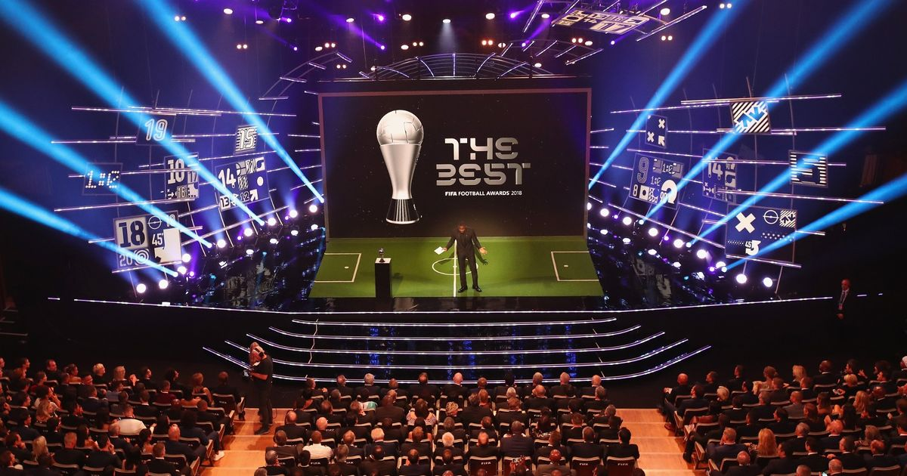
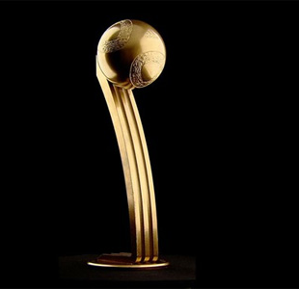
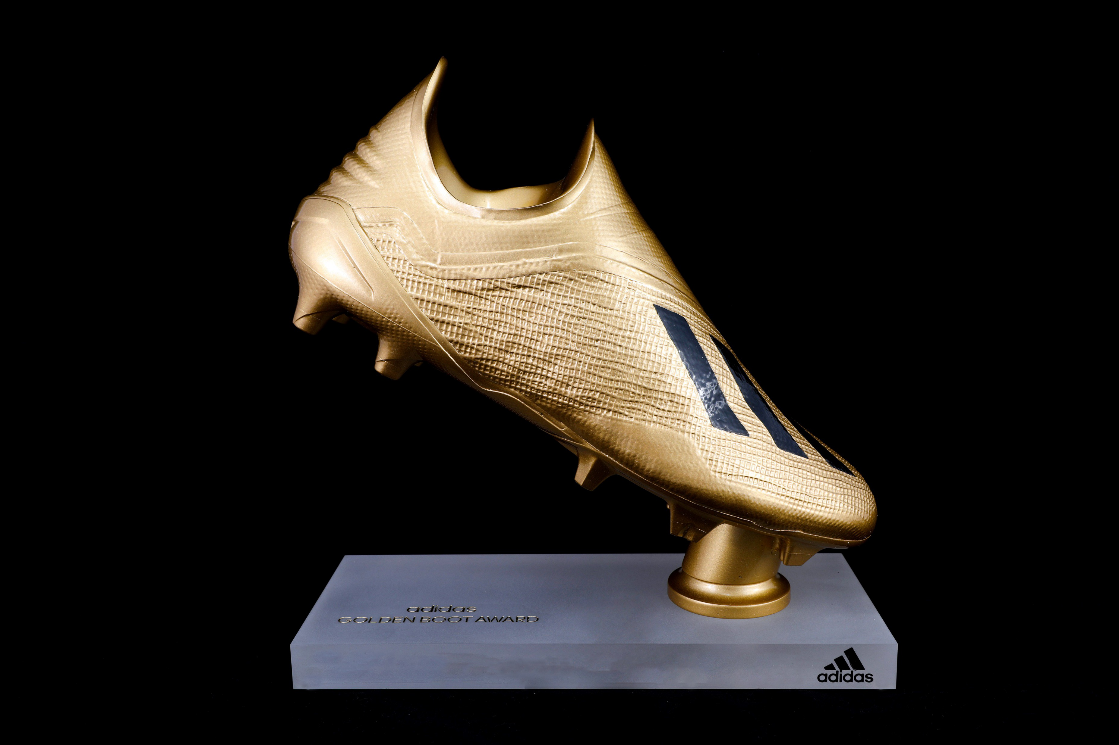
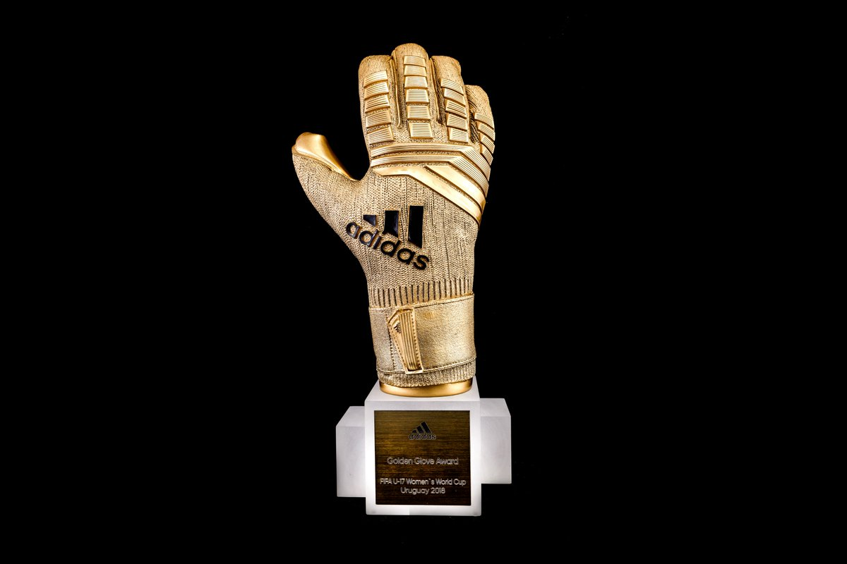
FIFA Awards
Golden Ball
Golden Boot
Golden Glove
Best Player
Top Goal Scorer
Best Goalkeeper

Slide 25








Organisers
FIFA Partners
Fédération Internationale de Football Association
Organising Committee for FIFA Competitions
FIFA World Cup Qatar 2022 LLC

Slide 26
Ticket Booking
The next opportunity to purchase tickets for the FIFA World Cup Qatar 2022™ will be a First Come First Served sales period. All purchases will be processed as real-time transactions, on a first come, first served basis, subject to availability. Tickets successfully purchased will be confirmed immediately to ticket applicants.
Visit:
FIFA.com/tickets
FIFA WORLD CUP

Slide 27
THANK YOU

Slide 28
INSTRUCTIONS FOR USE
You must credit Slidechef in order to use this template
What you are allowed to do :
Modify this template
Use it for personal or commercial projects
What you are not allowed to do :
Offer Slidechef templates for download
Sublicense, sell or rent any Slidechef content
Distribute Slidechef content unless it has been authorized
Include Slidechef content in an online or offline file
Acquire the copyright of Slidechef content

Slide 29

Slide Chef

